Slide 1

Unlocking Insights
Power BI Workshop

Slide 2



Welcome!
Data Enthusiast and an Analytics Engineer at
Lan Nguyen

Slide 3

What do you already know about Power BI?
Please log into Menti.com
Use the code
7917 4080

Slide 4
Workshop Goals
Understand Power BI Fundamentals
Learn the basic features and functionalities of Power BI
Data Visualization: Master techniques for creating visually appealing and insightful reports and dashboards.
Data Transformation: Explore data import, cleaning, and transformation processes to prepare datasets for analysis.
Real-World Applications: Apply Power BI skills to real-world business scenarios and case studies.

Slide 5
Get started with Power BI and its concepts
Business intelligence is about
    Connecting business decision-making to facts about the business and its environment
    To take a deep dive and understand the data underneath your business
    Make better business decisions
The increasing growth of business and integration of new enterprise tools generate overwhelming volumes of data. Hence, IT and Business are required to develop a great understanding of what is needed to retrieve exactly from data to generate informative insights.
    Microsoft Excel: first alternative of self-service business intelligence.
    Microsoft Power BI: continues and offers wider range of functionality from Excel

Slide 6

What is Power BI?
Data visual and dashboarding tool from Microsoft
The BI in Power BI is short for Business Intelligence.
“Business intelligence (BI) comprises the strategies and technologies used by enterprises for the data analysis and management of business information.”
In informal terms, BI leverages software and services that enables transforming data into informative actionable insights.

Slide 7

What can Power BI do?
Connect to (multiple) data source(s)
Enable to load and transform data
Custom calculations and KPIs
Enable users to slice-dice, filter data cubes
Enable users to explore and test their hypothesis

Slide 8
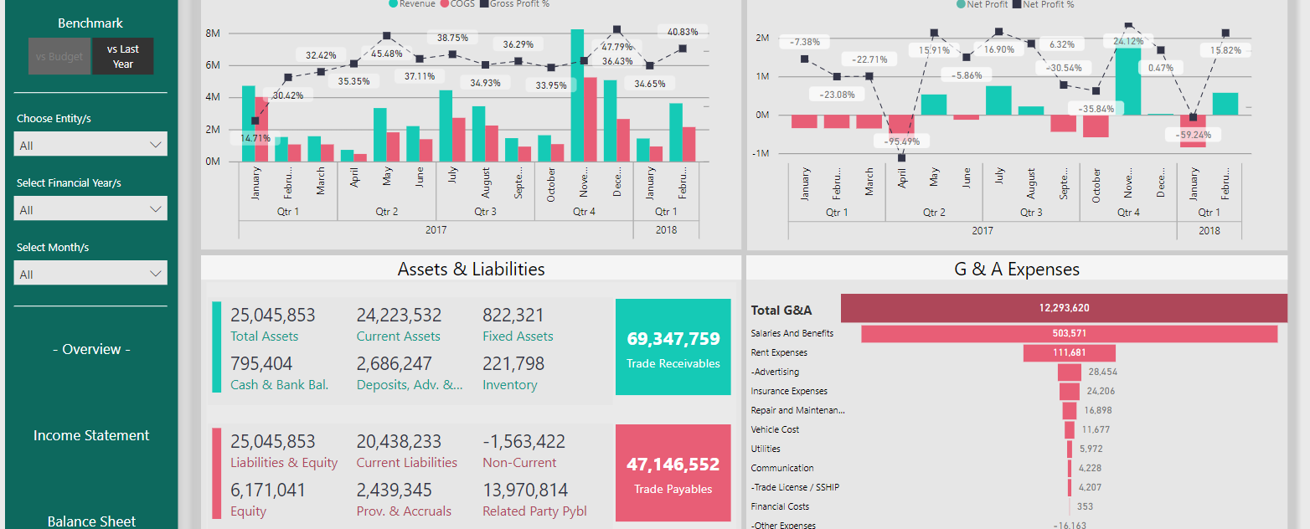
Some dashboard inspirations

Slide 9
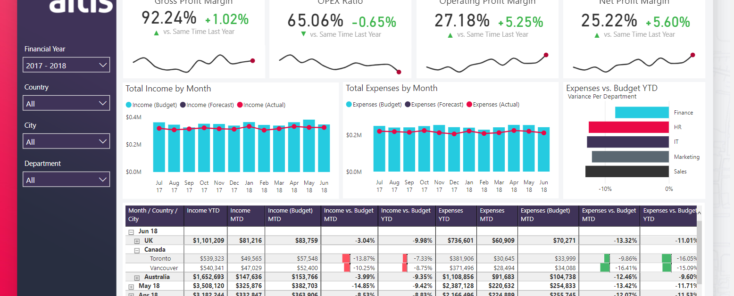
Some dashboard inspirations

Slide 10

Power BI Pros & Cons
Power BI Workshop
Cons
Max size of report is 2GB
Data is still loaded into memory
Connections to the data warehouse still need to be configurated. In CBS, we still need to setup the ODBC connection in our Workspace.
Pros
Multiple data source connections
Enable slice-dice data to explore the data
Custom Visual presentation of the report with multiple filter options
Interactive Visualizations

Slide 11
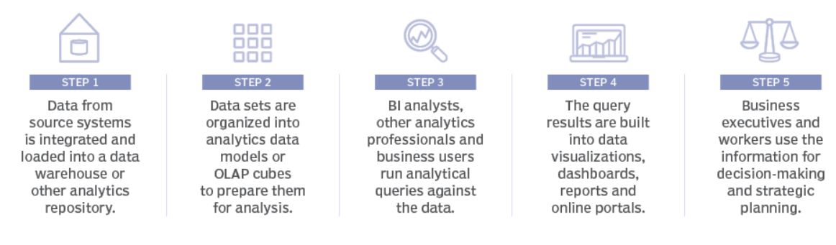

What are BI processes and where does Power BI fit in?
Power BI Workshop
Notes:
When looking up for BI processes in Google, you will find a lot of diagrams and explanations of different process stages data goes through before it could provide useful information or insights.

Slide 12
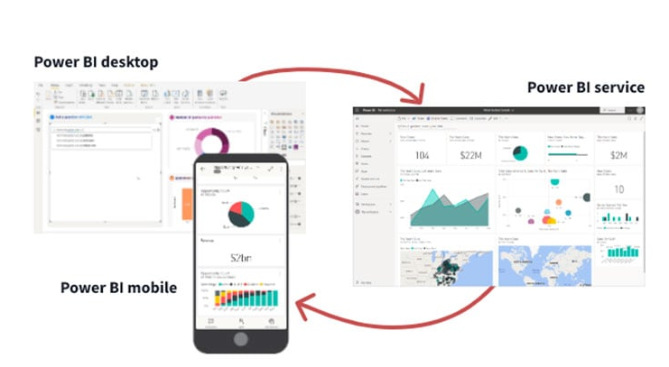
Useful Information
What are the services of PowerBI?

Slide 13
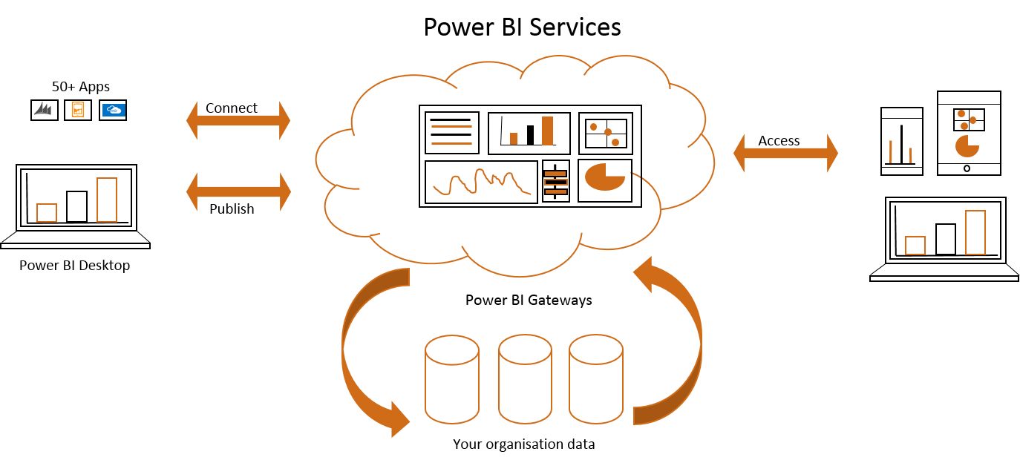
Useful Information
What are the services of PowerBI?

Slide 14
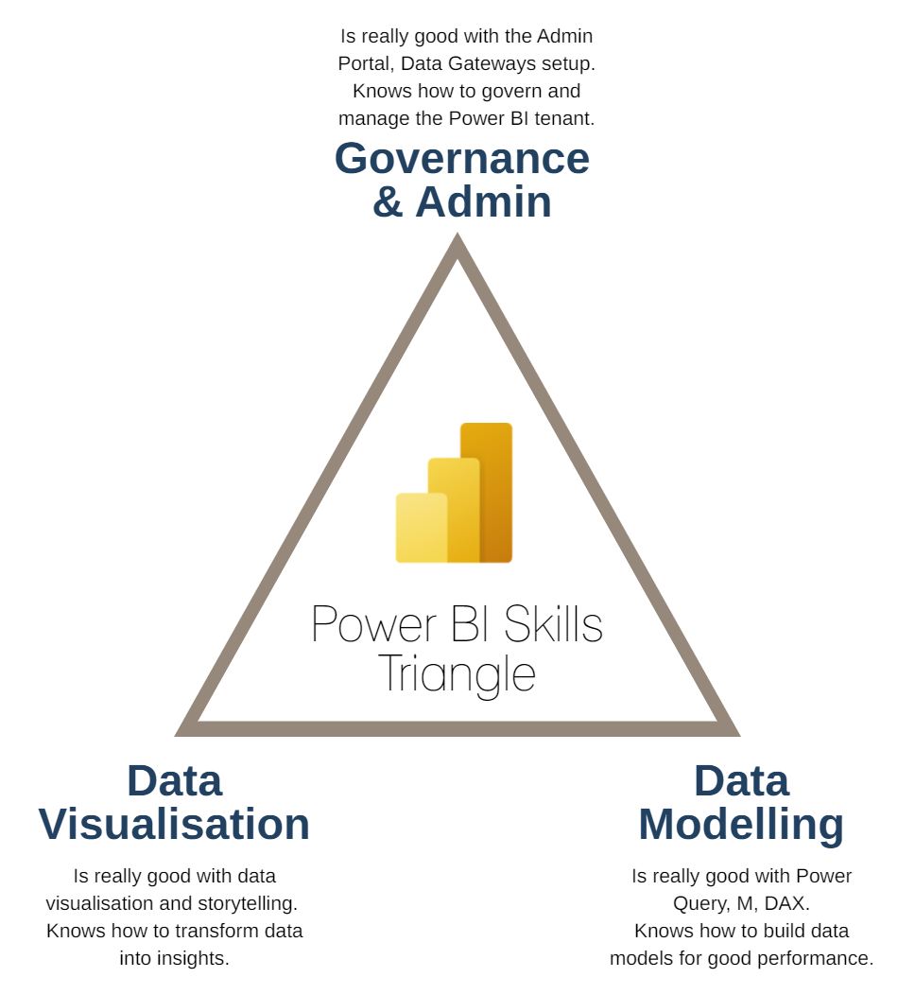
Useful Information
What do you need to become a Power BI expert?

Slide 15
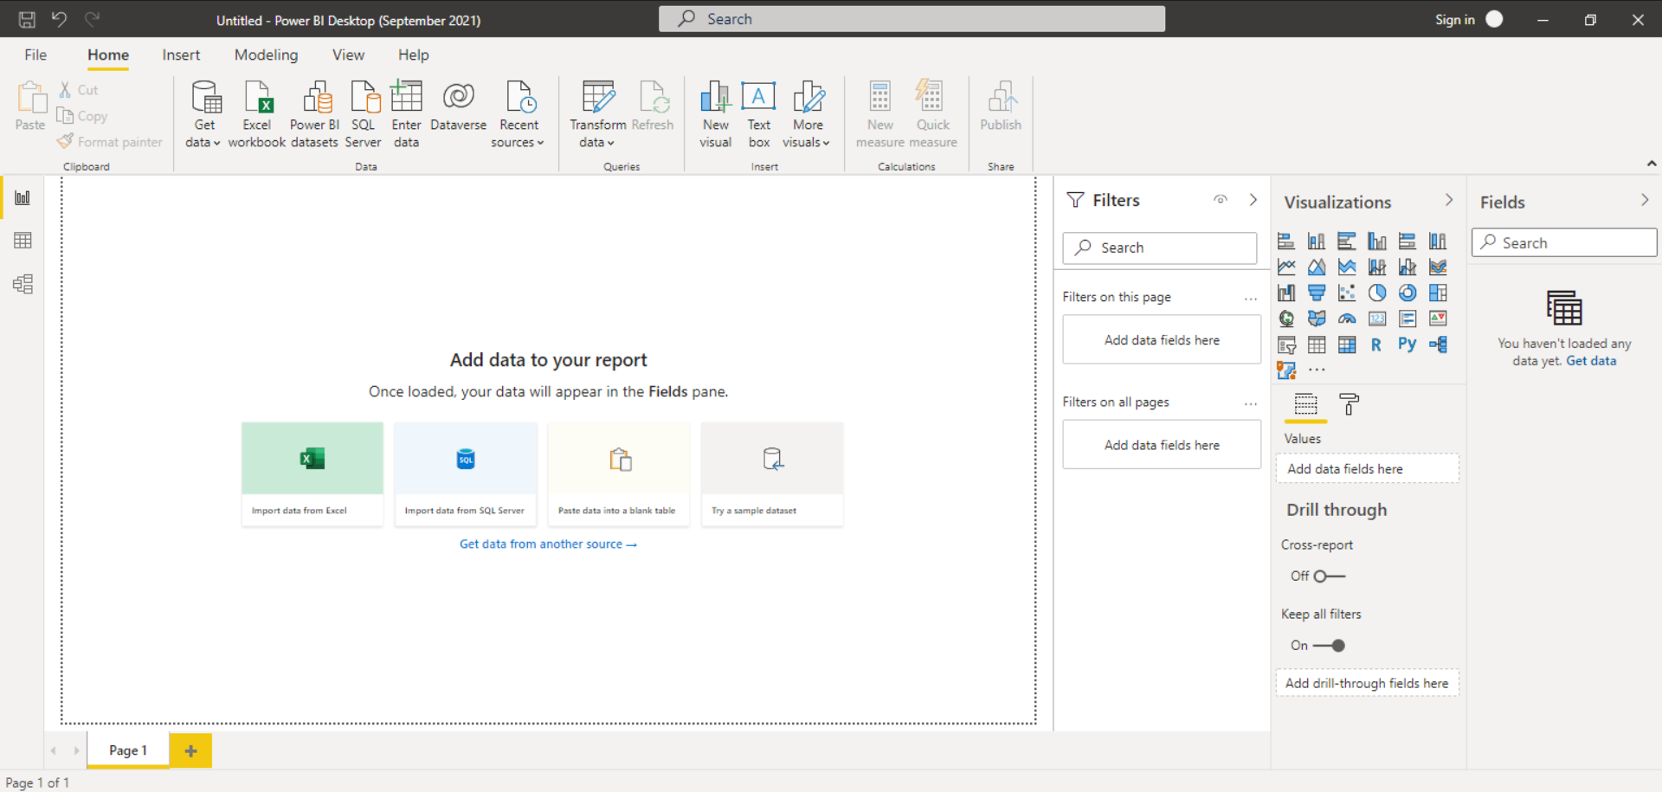
Components in Power BI Desktop
User-interface for building visualizations
Power BI Workshop
Menu
Toolbar
Out-of-toolbox
(OOTB) visuals
Filter pane
Data source fields
Layout Pane
Visuals’ input
parameter fields
Pages

Slide 16
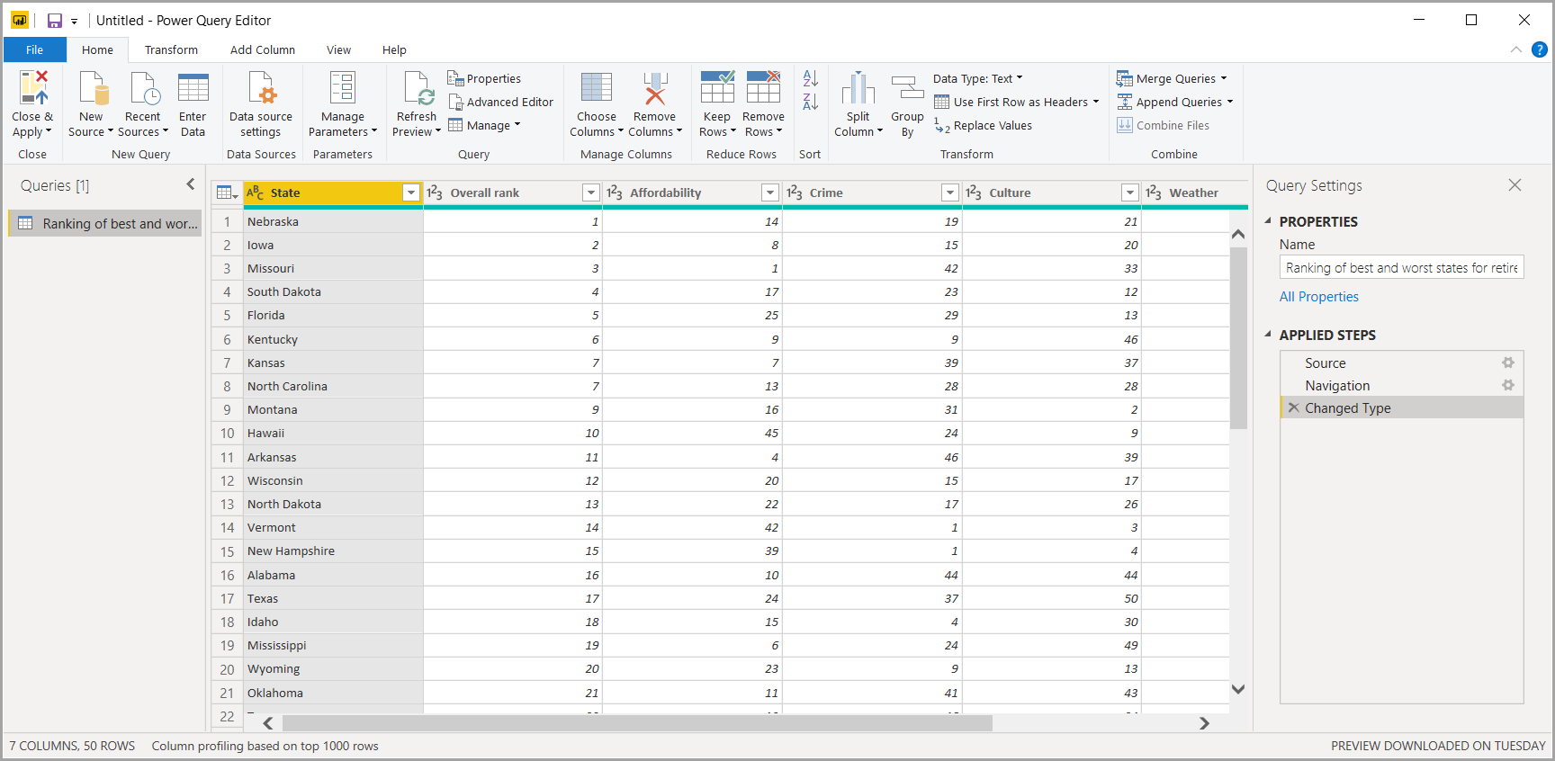
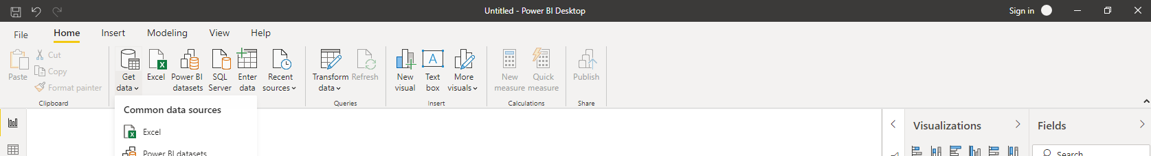
Components in Power BI Desktop
User-interface for importing and transforming data – Power Query Editor
Menu
Toolbar
Query working view
Query pane
Query setting pane

Slide 17

Download the workshop materials
Scan the QR code or log into our website
https://synergy-solution.org/resources/
and download the materials for this workshop.
Password: Vanlangpowerbi

Slide 18
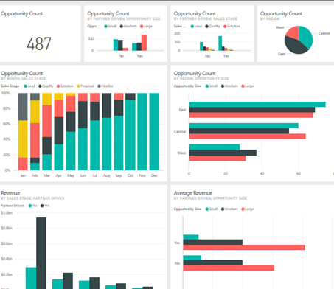
Hands-on pracise with PowerBI

Slide 19

Connecting to data sources

Slide 20
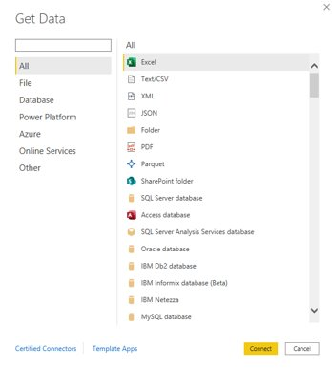
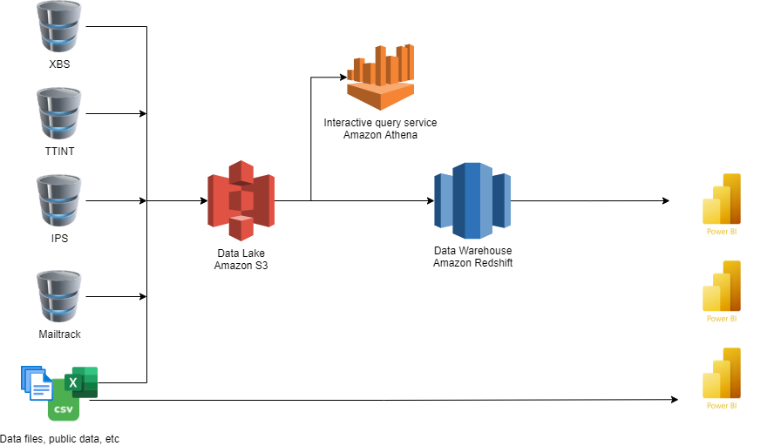
Connecting to data sources
Importing data into Power BI
PowerBI Workshop

Slide 21
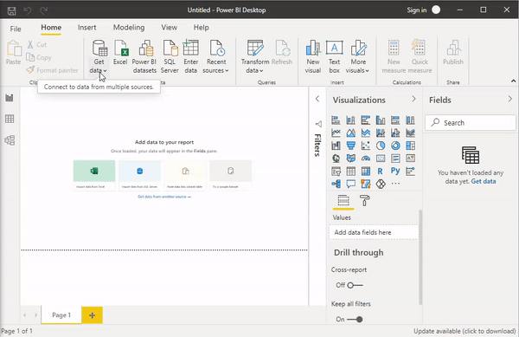
Practice
Load data in Power BI desktop
PowerBI Workshop
More options to connect to different data sources can be found in Power BI.

Slide 22
Connecting to data sources
Connecting to Data source (Postgres)
PowerBI Workshop
Load data from a database to Power BI
      Without SQL
      With SQL
But first, we need to setup an ODBC configuration
Open Database Connectivity (ODBC) is a standard application programming interface (API) for accessing database management systems (DBMS)

Slide 23
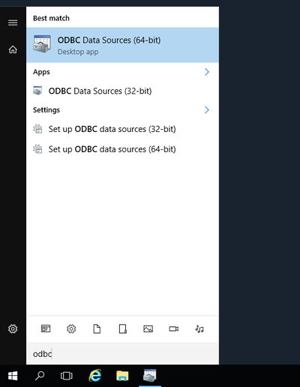
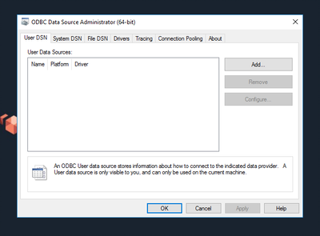
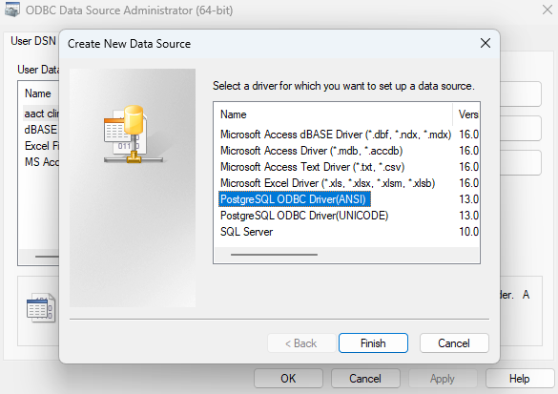
Configurate ODBC connection to a Postgres Database
PowerBI Workshop

Slide 24
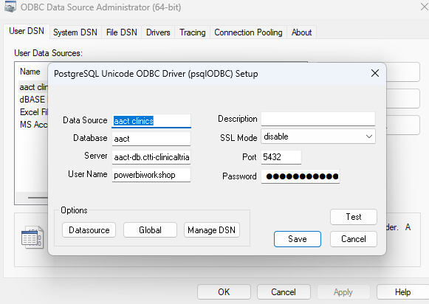
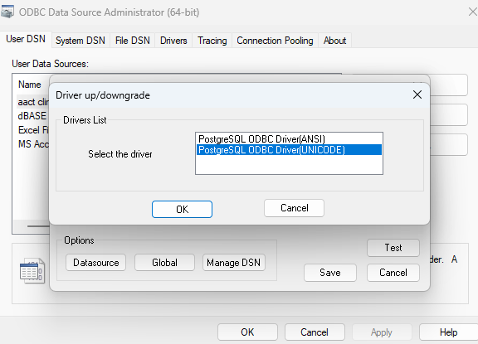
Configurate ODBC connection to a database
PowerBI Workshop
Hostname: aact-db.ctti-clinicaltrials.org
Port: 5432
Database name: aact
Username: powerbiworkshop
Password: Vanlangpowerbi

Slide 25
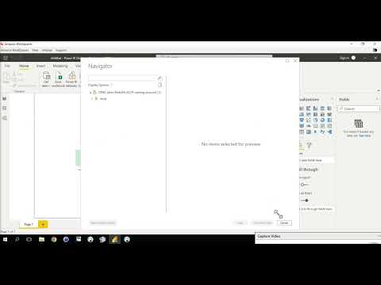
Load data from a database in Power BI
Without SQL query
PowerBI Workshop
Press Get Data --> More.. and search and select ODBC
Select the ODBC that you have configured.
Fill in Database credentials (one-time action), and press OK
Press Load data

Slide 26

Load data from a database in PowerBI
With SQL query
PowerBI Workshop
Check for exploratory SQL query from the AACT database site (https://aact.ctti-clinicaltrials.org/queries )
Press Get Data --> More.. and search and select ODBC
Select the ODBC that you have configured.
Press advanced options and paste a prepared SQL statement to load data
Fill in Database credentials (one-time action), and press OK
Press Load data
SELECT *
FROM studies
JOIN sponsors ON studies.nct_id = sponsors.nct_id
WHERE sponsors.agency_class = 'INDUSTRY'
AND is_fda_regulated_drug = TRUE
AND study_type = 'INTERVENTIONAL'
AND start_date > (CURRENT_DATE - INTERVAL '10 years')
AND start_date <= (CURRENT_DATE)
AND studies.phase LIKE '%PHASE2%'
ORDER BY random()
LIMIT 1000;

Slide 27
Transform data
Via Power BI in AWS Workspace

Slide 28
Pre-process and transform data
Using Power Query Editor in Power BI
PowerBI Workshop
Menu
Toolbar
Query setting pane
Query working view
Query pane

Slide 29
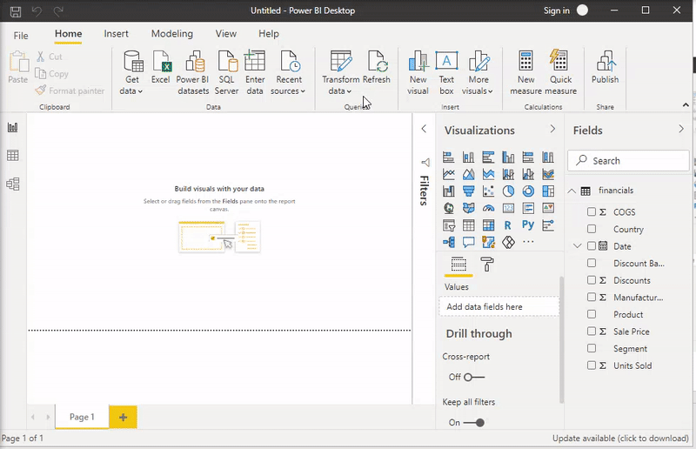
PowerBI Workshop
Pre-process and transform data
Using Power Query Editor in Power BI
Preprocessing and creating additional columns can be done in Power BI’s Power Query Editor.
Transform data activities include:
  Transpose
  Reverse Rows
  Change data types
  Replace values
  Add (custom) columns
  Split values
  Group by
  Create input parameters
Notes:
Total_unit_sold_groupby_discountband = CALCULATE(SUM(financials[Units Sold]),ALLEXCEPT(financials,financials[Country],financials[Product]))

Slide 30
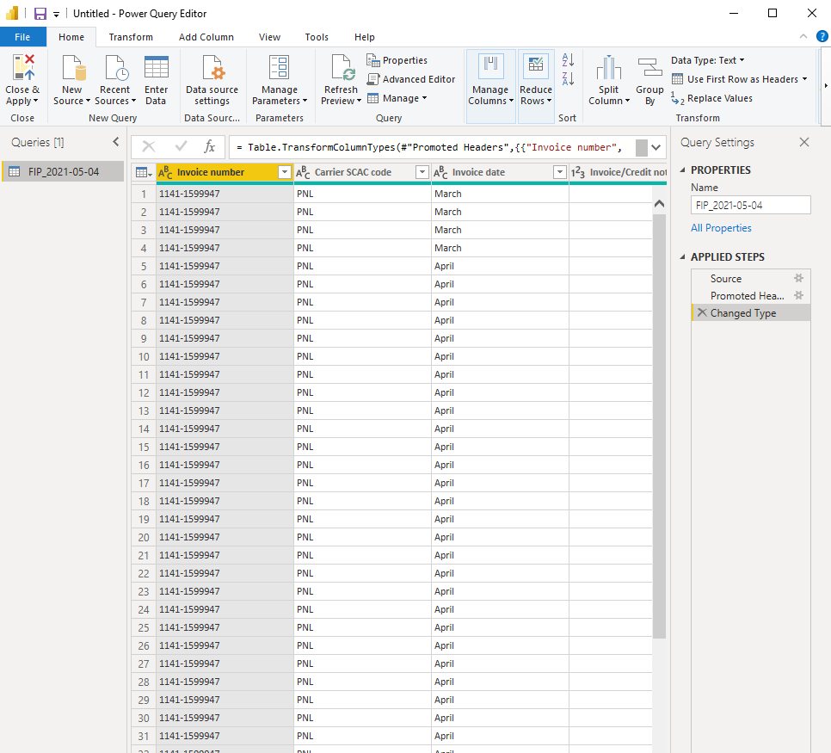
Transforming data in Power BI
Data types
Transform columns
Add new columns
Format texts
  Split text by separator
  Change format text (uppercase/lowercase)
  Replace subtexts/substrings

Slide 31


Practice time! Import and Transforming data
Questions
PowerBI Workshop
All input file or query can be found in https://synergy-solution.org/resources/
Password: Vanlangpowerbi
Load data from excel xbs_archive_data
Transform all Date Time columns into Date columns
From column "carrier", extract only the labels: Packet, Packeta, Parcel
Rename the newly added column

Slide 32

Practice time! Import and Transforming data
Show us your outcome!
PowerBI Workshop

Slide 33
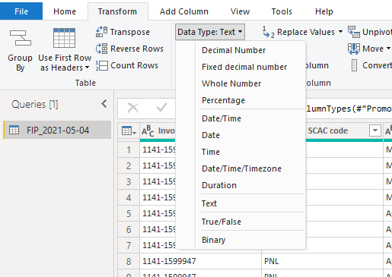
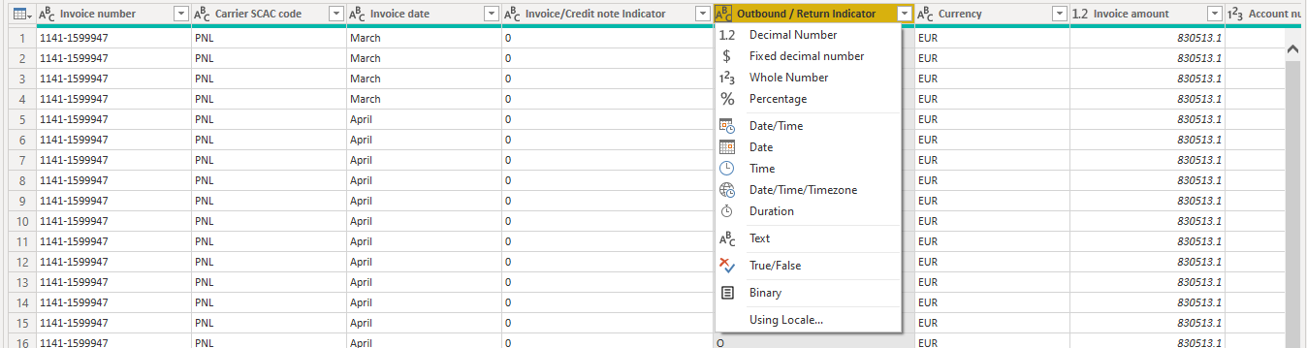
Data Types
PowerBI Workshop
Texts / Strings
Whole Number / Integer
Decimal Number / Float
Booleans
Date/DateTime

Slide 34
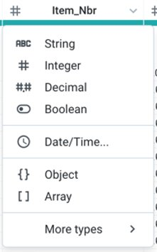
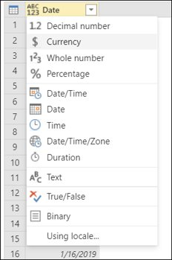
Data Types
Data Types | Examples
String | ‘Hello world’ ‘12345’ ‘’ ‘ ’
Integer | 45 923 8373
Float | 23,34 6,02 32.89 7.03
Booleans | True/False
Date | MM/DD/YYYY 12/25/2021 DD/MM/YYYY 25/12/2021 YYYY-MM-DD 2021-12-25
Date Time | 02/03/2021 23:03:45 MM/DD/YYYY HH:mm:SS
Blanks
Texts / Strings (str)
Whole Number / Integer (int)
Decimal Number / Float
Booleans
Date/DateTime

Slide 35
Data Types – date time data types
Timestamp data type
Date data type
Time data type
10 characters positions
8 characters positions
Date data type
Time data type
YYYY – MM – DD
HH : mm : SS
YYYY – MM – DD HH : mm : SS
Year
Date
Hour
Seconds
Month
Minutes

Slide 36
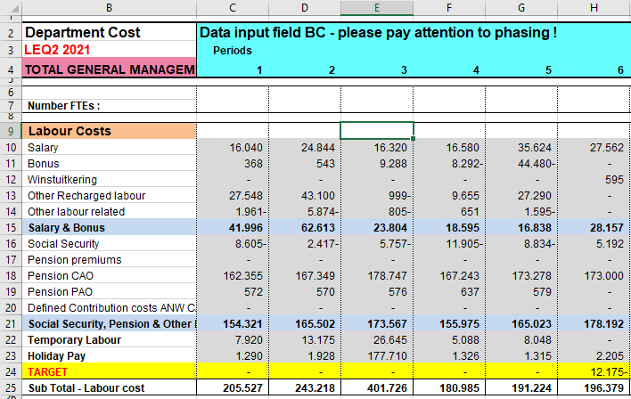
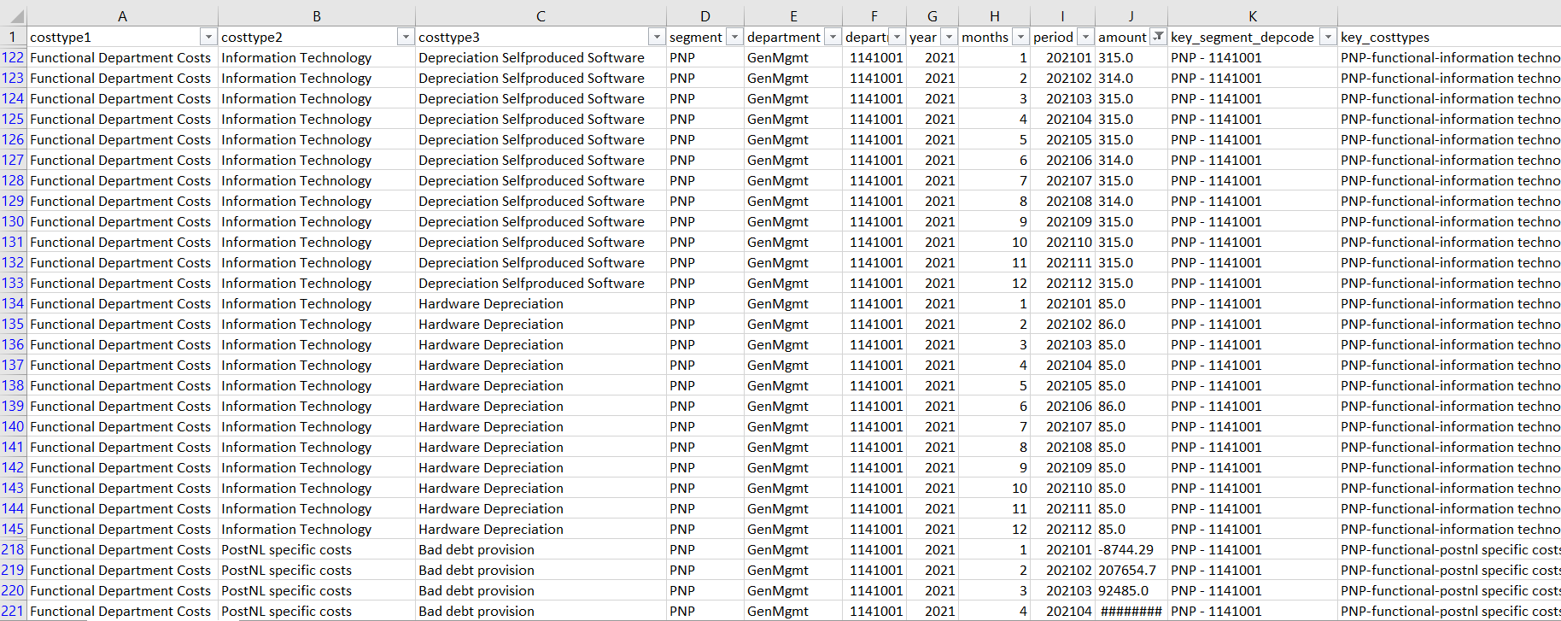
The risk of using Excel as a data source
PowerBI Workshop
Data that comes from a report style instead of as a read-to-consume data for PBI

Slide 37
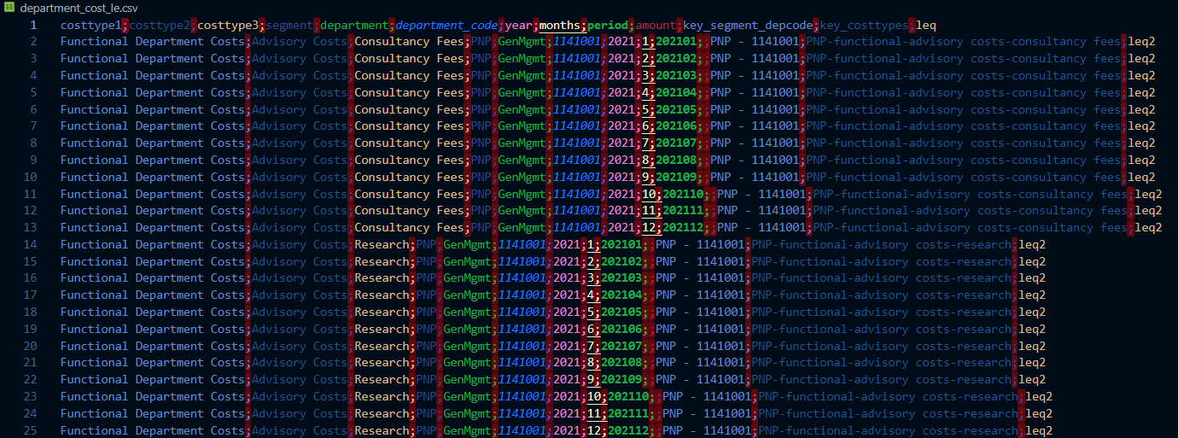
The risk of using Excel as a data source
PowerBI Workshop
Separators default difference between Excel/CSV and PowerBI
Excel has default standards that transform data automatically, particularly with date/datetime types of data.
When open an Excel file, it could change the date/datetime data types automatically.

Slide 38


Please fill in this form for future update
Break time & Feedback

Slide 39
Explore the data
Via Power BI

Slide 40
Explore the data or make changes
Using Power BI User-interface for building visualizations
PowerBI Workshop
Menu
Toolbar
Out-of-toolbox
(OOTB) visuals
Filter pane
Data source fields
Layout Pane
Visuals’ input
parameter fields
Pages

Slide 41
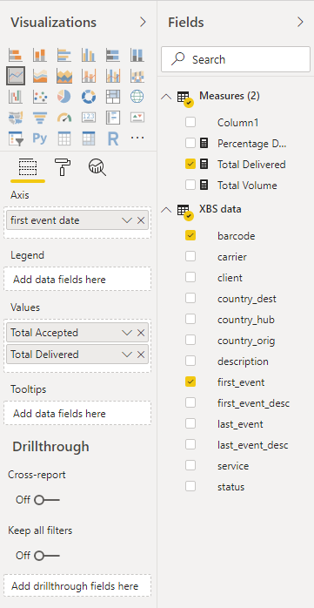
Create visuals in Power BI desktop
PowerBI Workshop
Select visual in at the top of the Visualizations pane and drag to the dashboard canvas
  (Stacked) Line graph
  (Stacked) Bar chart
  Pie chart
  Table/matrix
  KPI
  Add Filters using the Slicer visual
  Etc.
Add values from Fields pane to Visualizations pane
Format and style the visual in the second tab of the Visualizations pane

Slide 42
Practice time! Creating visuals in Power BI
Questions
PowerBI Workshop
Create a visual that answer the following questions:
Which carrier has the highest number of items?
From this carrier, what is the highest percentage of the items' status?
What is the number of items been tracked over time?

Slide 43
Practice time! Creating visuals in Power BI
Show us your outcome!
CBS BI & Analytics

Slide 44
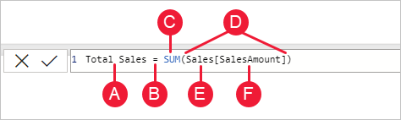
Creating KPIs in Power BI with DAX
PowerBI Workshop
When implementing business calculation, it is best to use Data Analysis Expressions (DAX) in Power BI.
What is DAX?
DAX is a language that makes use of many functions and operators to build formulas, expressions or calculations. The goal is to create new information from data that already exist in your model.
Some of DAX functions are similar to regular Excel functions, but some are not.
To know more about DAX functions and how they are applied, you can check the DAX guide or Microsoft’s DAX Reference page.
​
What are DAX syntax elements?​
A. The measure name, Total Sales.​
B. The equals sign operator (=), which indicates the beginning of the formula. When calculated, it will return a result.​
C. The DAX function SUM, which adds up all of the numbers in the Sales[SalesAmount] column. You’ll learn more about functions later.​
D. Parenthesis (), which surround an expression that contains one or more arguments. Most functions require at least one argument. An argument passes a value to a function.​
E. The referenced table, Sales.​
F. The referenced column, [SalesAmount], in the Sales table. With this argument, the SUM function knows on which column to aggregate a SUM.​

Slide 45
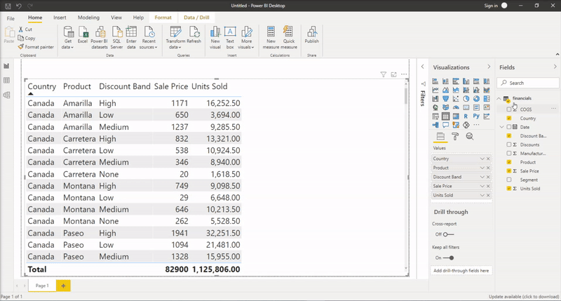
Creating KPIs with DAX in Power BI
PowerBI Workshop
In the the Modeling tab press New Measure
A box with Measure = will pop-up at the top of the screen
Here you can create a measure using DAX for:
Counts
  Count (distinct) barcodes - (COUNT(barcodes))
Sumations
  Get total weight/revenue/costs - (SUM(item_weight)))
Percentages
  Percentage of volume that is delivered - COUNT(items_delivered))/COUNT(items_total)
Averages
  Average weight per item (AVERAGE(item_weight))

Slide 46
Practice time! Creating KPIs with DAX in Power BI
Questions
PowerBI Workshop
Create a tailored Measurement that calculates the following KPIs:
Calculate the date difference between the items' creation date and last tracked event.
Calculate the average of weight (g) of items per carrier and service provided.
Calculate the total amount of value of "IN TRANSIT" items for each carrier.
Notes:
select
carrier_tracking_number as barcode
, carrier
, client
, shipper_country_code
, hub_country_code as country_hub
, consignee_country_code
, requested_service
, service
, status
, creation_time
, accept_time
, first_tracking_event_time
, springdeparture_time
, carrierarrival_time
, carrierfirstdelivery_time
, carrierfinaldelivery_time
, last_tracking_event_time
, last_tracking_event_description
, weight
, weight_unit
, dim_length
, dim_width
, dim_height
, value
from xbs.xbs_archive
where carrierarrival_time between '2020-10-31 00:00:00' and getdate()
order by creation_time

Slide 47
Practice time! Creating visuals in Power BI
Show us your outcome!
PowerBI Workshop

Slide 48
Publish Power BI dashboard
Via Power BI in Workspace

Slide 49
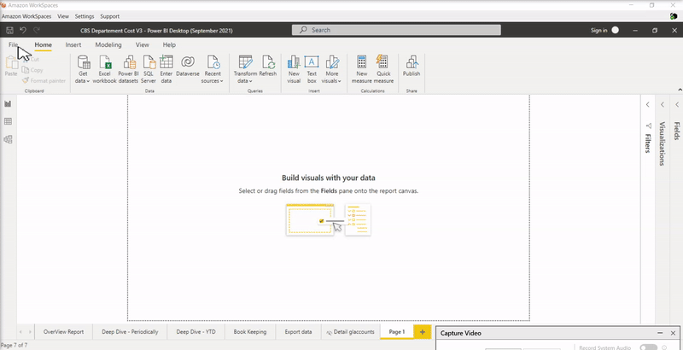
Publishing report on Power BI report server
PowerBI Workshop
Power BI reports ready to be published on a Power BI Report Server or your own Workspace.

Slide 50
Summary of this session
PowerBI Workshop
Introduction into Power BI and Power BI in AWS Workspace.
Connecting to data sources via Power BI in AWS Workspace:
  Excel/CSV data dumps
  Redshift data warehouse
Explore data or make changes in Power BI
  Load data
  Explore data and preprocessing
  Create data visuals and filters
  Publish reports for others to view

Slide 51
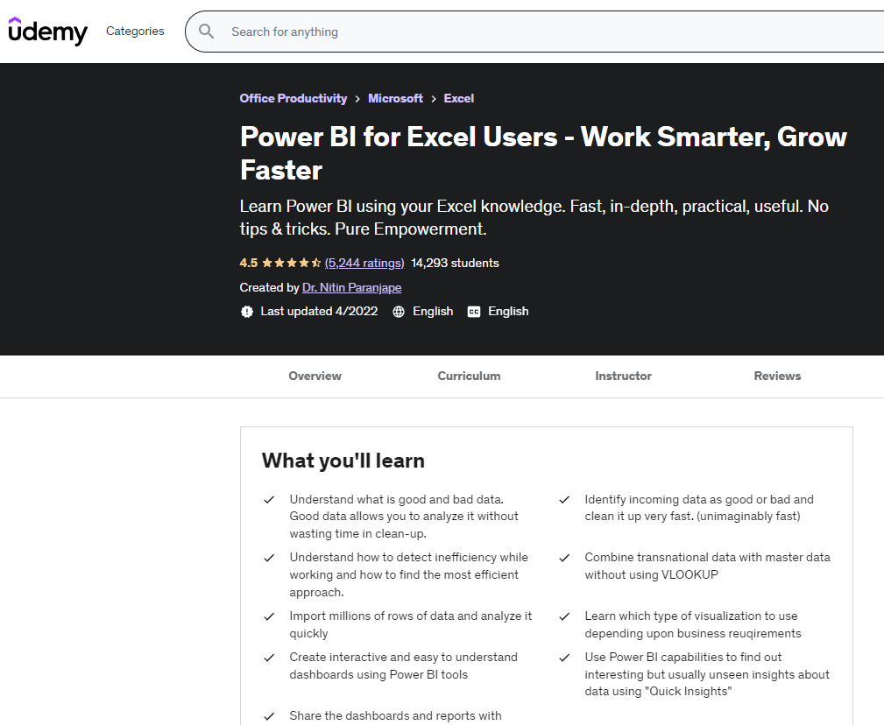
Recommended follow up trainings
PowerBI Workshop
Power BI for Excel Users - Work Smarter, Grow Faster

Slide 52

Recommended follow up trainings
PowerBI Workshop
Microsoft Certified: Data Analyst Associate with Power BI

Slide 53



Please fill in this attention form

